Slide 1
Dart
Programming Language

Slide 2
1. Overview
Object Oriented Language
Developed By Google
Primarily used for building websites, servers, and mobile apps
Provides librariries, an editor, a virtual machine (VM) and a compiler to javaScript
Created to improve the developers experience based on performance and productivity

Slide 3
2. History
Unveiled at the GOTO conference in Denmark on October 10, 2011
Founded by Lars Bak and Kasper Lund
Bak is a Danish computer programer who previously developed the V8 JavaScript Interpreter for Chrome
V8 is mostly responsible for Chromes success
Google then moved most of the V8 engineers to the Dart project

Slide 4
2. History
ECMA (European Computer Manufacturers Association) formed a technical committee TC52 to work on Dart Language Standards
TC52 goals:
Develop Dart standards and standards for libraries that extend the capabilities of dart
After completing 1, investigate the future direction of Dart standards, and to evaluate and consider proposals for additional technology
Develop test suites that will be used to verify the correct implementation of these standards.
Establish/Maintain liaison with other TCs and with other SDOs (Standards Development Organizations) as appropriate to facilitate/promulgate the work of the groups

Slide 5
3. Concepts
Everything you can place in a variable is an object, and every object is an instance of a class. All objects inherit from the Object class.
Specifying static types clarifies your intent and enables static checking by tools, but it’s optional.
Dart doesn’t have the keywords public, protected, and private. If an identifier starts with an underscore “_”, it is private to its library.
Identifiers can start with a letter or “_”, followed by any combination of those characters plus digits.

Slide 6
3. Concepts
Dart parses all your code before running it. You can provide tips to Dart, for example, by using types or compile-time constants, to catch errors or help your code run faster.
Dart supports top-level functions. You can also create functions within functions (nested or local functions).
Dart supports top-level variables, as well as variables tied to a class or object (static and instance variables).

Slide 7
3. Concepts
Dart tools can report two kinds of problems: warnings and errors.
Dart has two runtime modes: production and checked.
Production mode is the default runtime mode of a Dart program, optimized for speed. Production mode ignores assert statements and static types.
Checked mode is a developer-friendly mode that helps you catch some type errors during runtime

Slide 8
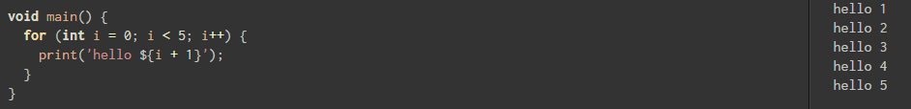
4. Example
String Interpolation

Slide 9
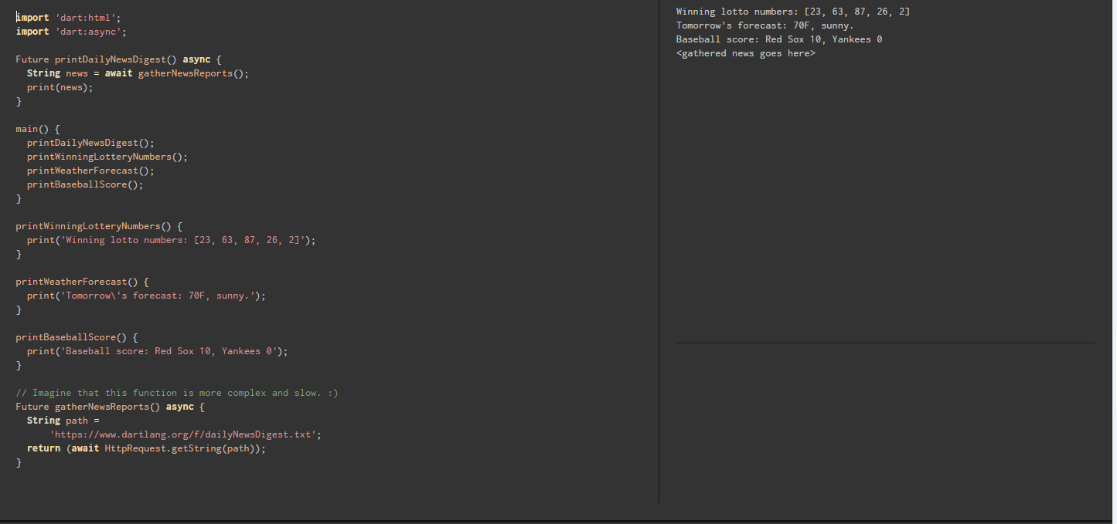
4. Example
Asynchronicity

Slide 10
Comparisons
Descendant of the ALGOL language family, just like C, Java, C# and JavaScript
Dynamically typed language like Javascript, but Dart adds the optional type annotations to help catch errors earlier
Dart takes out a few features of JavaScript (Prototypes, Global Objects) causing the VM to streamline, enables faster execution and makes it easier to do code completion and re-factoring
According to the Dart Project “When compared to JavaScript, Dart aims to be faster, more regular, and more scalable to large programs.”

